Slide 1

Colorado State University
Automated FISH Processing – Python Module
Luis Aguilera
50% Tim Stasevich Group
50% Brian Munsky Group
Notes:
Today I am going to talk to you about the work Luis and I have been doing lately. We have been working on simulating cell data of single-cell mRNA translation.

Slide 2
Presentation overview
Image processing
Current pipeline
New pipeline (Version Control – Automated – Documented)
Large-scale data management and interpretation
Implementing version control, automation , and documentation
Demonstration
Remote computer (Secure Shell -SSH) and NAS (network accessed storage)
Notes:
In rSNAPed, the simulated software, we are implementing a fully automated pipeline that allows the analysis of single-molecule data sets. rSNAPed models single-mRNA translation using observable fluorescence and mechanistic interpretation.
Segmentation is the first step of the process. Cellpose is a cellular segmentation algorithm written in Python. It is an open-source package that is freely available. It allows us to transform raw simulated image data into interpretable data that we can apply to our experiments. The first step in image segmentation is to segment the images into cell bodies. This is relatively easy when the cells are sufficiently separated from each other, but can become more difficult if the cells are tightly packed together. A mask is then created around the cell bodies with pixels, and all of the pixels are trying to point towards the center. All of these pixels conglomerate as one cell.
The second part of the image processing pipeline includes Trackpy, a python package that tracks dots. It allows us to track fluorescent antibody-based probes that are bound to nascent proteins on single-RNA cells only visible by their beacons of light. The image is represented as a numpy array of intensities. We end up with a field of tracked particles. Results are given as data frames that can be easily saved.
After tracking the spots, we quantify the data by comparing the intensity distributions. We can quantify intensity in every spot. This is done in one method by using disk and donut. You take a tracked spot, and travel a disk and a donut outside of the spot. After drawing a donut outside of the spot, you can calculate the mean intensity of donut and the intensity in the disk.
We then classify these spot intensities based on their color channels. The images have three different color channels: red, blue, and green. We can classify the spots through either single color channels of red, blue, and green, or the combinations of them.
Every part of this pipeline is connected to the simulated cell. It allows us to generate large amounts of data to fully automate the pipeline.

Slide 3





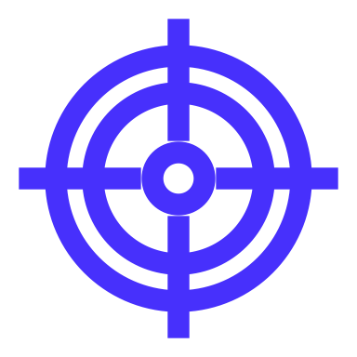


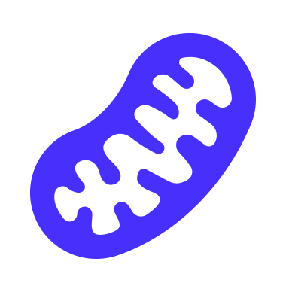







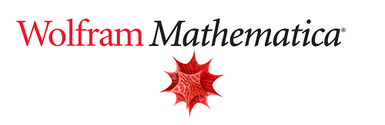


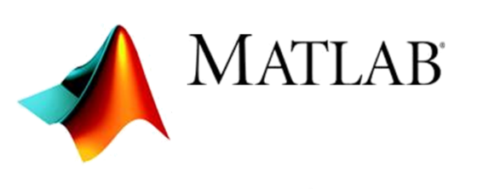
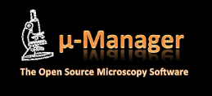




Current pipeline
Experimental data
Image Processing
Modeling
Visualization and Interpretation
x₂
Gene construct
x₁
x₃
Segmentation
Spot detection
and tracking
Data management
Simulated data
Model selection
+
Biophysical parameters
Microscope images
Implementation:
Revision, changes
Notes:
In rSNAPed, the simulated software, we are implementing a fully automated pipeline that allows the analysis of single-molecule data sets. rSNAPed models single-mRNA translation using observable fluorescence and mechanistic interpretation.
Segmentation is the first step of the process. Cellpose is a cellular segmentation algorithm written in Python. It is an open-source package that is freely available. It allows us to transform raw simulated image data into interpretable data that we can apply to our experiments. The first step in image segmentation is to segment the images into cell bodies. This is relatively easy when the cells are sufficiently separated from each other, but can become more difficult if the cells are tightly packed together. A mask is then created around the cell bodies with pixels, and all of the pixels are trying to point towards the center. All of these pixels conglomerate as one cell.
The second part of the image processing pipeline includes Trackpy, a python package that tracks dots. It allows us to track fluorescent antibody-based probes that are bound to nascent proteins on single-RNA cells only visible by their beacons of light. The image is represented as a numpy array of intensities. We end up with a field of tracked particles. Results are given as data frames that can be easily saved.
After tracking the spots, we quantify the data by comparing the intensity distributions. We can quantify intensity in every spot. This is done in one method by using disk and donut. You take a tracked spot, and travel a disk and a donut outside of the spot. After drawing a donut outside of the spot, you can calculate the mean intensity of donut and the intensity in the disk.
We then classify these spot intensities based on their color channels. The images have three different color channels: red, blue, and green. We can classify the spots through either single color channels of red, blue, and green, or the combinations of them.
Every part of this pipeline is connected to the simulated cell. It allows us to generate large amounts of data to fully automate the pipeline.

Slide 4

1 open-source programming language
Experimental data
Image Processing
Modeling
Visualization and Interpretation
x₂
Gene construct
x₁
x₃
Segmentation
Spot detection
and tracking
Data management
Model selection
+
Biophysical parameters
Simulated data
Microscope images
cellpose
trackpy
Big-FISH
x-array
pycro-manager
FISH processing
rsnapsim
croparray
Notes:
In rSNAPed, the simulated software, we are implementing a fully automated pipeline that allows the analysis of single-molecule data sets. rSNAPed models single-mRNA translation using observable fluorescence and mechanistic interpretation.
Segmentation is the first step of the process. Cellpose is a cellular segmentation algorithm written in Python. It is an open-source package that is freely available. It allows us to transform raw simulated image data into interpretable data that we can apply to our experiments. The first step in image segmentation is to segment the images into cell bodies. This is relatively easy when the cells are sufficiently separated from each other, but can become more difficult if the cells are tightly packed together. A mask is then created around the cell bodies with pixels, and all of the pixels are trying to point towards the center. All of these pixels conglomerate as one cell.
The second part of the image processing pipeline includes Trackpy, a python package that tracks dots. It allows us to track fluorescent antibody-based probes that are bound to nascent proteins on single-RNA cells only visible by their beacons of light. The image is represented as a numpy array of intensities. We end up with a field of tracked particles. Results are given as data frames that can be easily saved.
After tracking the spots, we quantify the data by comparing the intensity distributions. We can quantify intensity in every spot. This is done in one method by using disk and donut. You take a tracked spot, and travel a disk and a donut outside of the spot. After drawing a donut outside of the spot, you can calculate the mean intensity of donut and the intensity in the disk.
We then classify these spot intensities based on their color channels. The images have three different color channels: red, blue, and green. We can classify the spots through either single color channels of red, blue, and green, or the combinations of them.
Every part of this pipeline is connected to the simulated cell. It allows us to generate large amounts of data to fully automate the pipeline.

Slide 5
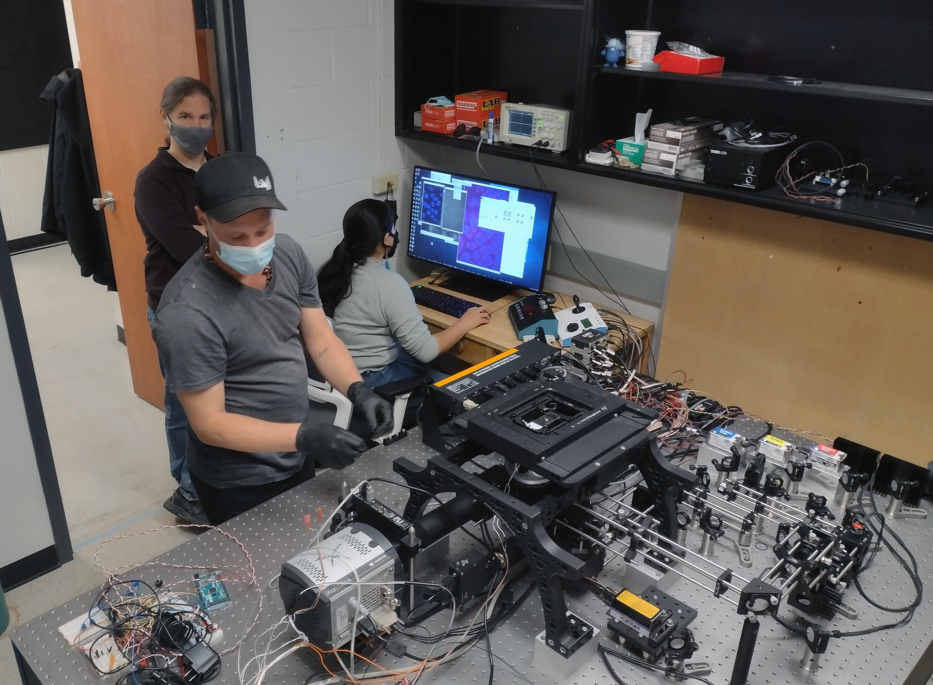




Justification
samples
terminator scope
(lots of) data
1 (FISH) stack images / 5sec
720 stack / hr
1 stack ~ 100Mb
~72 Gb / hr
Storage?
Transfer data?
Image processing time?
Computer?
Notes:
In rSNAPed, the simulated software, we are implementing a fully automated pipeline that allows the analysis of single-molecule data sets. rSNAPed models single-mRNA translation using observable fluorescence and mechanistic interpretation.
Segmentation is the first step of the process. Cellpose is a cellular segmentation algorithm written in Python. It is an open-source package that is freely available. It allows us to transform raw simulated image data into interpretable data that we can apply to our experiments. The first step in image segmentation is to segment the images into cell bodies. This is relatively easy when the cells are sufficiently separated from each other, but can become more difficult if the cells are tightly packed together. A mask is then created around the cell bodies with pixels, and all of the pixels are trying to point towards the center. All of these pixels conglomerate as one cell.
The second part of the image processing pipeline includes Trackpy, a python package that tracks dots. It allows us to track fluorescent antibody-based probes that are bound to nascent proteins on single-RNA cells only visible by their beacons of light. The image is represented as a numpy array of intensities. We end up with a field of tracked particles. Results are given as data frames that can be easily saved.
After tracking the spots, we quantify the data by comparing the intensity distributions. We can quantify intensity in every spot. This is done in one method by using disk and donut. You take a tracked spot, and travel a disk and a donut outside of the spot. After drawing a donut outside of the spot, you can calculate the mean intensity of donut and the intensity in the disk.
We then classify these spot intensities based on their color channels. The images have three different color channels: red, blue, and green. We can classify the spots through either single color channels of red, blue, and green, or the combinations of them.
Every part of this pipeline is connected to the simulated cell. It allows us to generate large amounts of data to fully automate the pipeline.

Slide 6

Justification
Processing (lots of) data, challenges:
Multi-step process (Segmentation, Spot Detection, Quantification).
Labor intensive
Multiple steps require user input (to select thresholds)
User-to-user variability
Large and complex datasets that are:
Difficult to transfer between computers (local/remote)
Difficult to interpret
Difficult to apply (new/retrospective) changes
Use of infrastructure (NAS-Cluster-GPUs)
Requires a skilled user
Notes:
In rSNAPed, the simulated software, we are implementing a fully automated pipeline that allows the analysis of single-molecule data sets. rSNAPed models single-mRNA translation using observable fluorescence and mechanistic interpretation.
Segmentation is the first step of the process. Cellpose is a cellular segmentation algorithm written in Python. It is an open-source package that is freely available. It allows us to transform raw simulated image data into interpretable data that we can apply to our experiments. The first step in image segmentation is to segment the images into cell bodies. This is relatively easy when the cells are sufficiently separated from each other, but can become more difficult if the cells are tightly packed together. A mask is then created around the cell bodies with pixels, and all of the pixels are trying to point towards the center. All of these pixels conglomerate as one cell.
The second part of the image processing pipeline includes Trackpy, a python package that tracks dots. It allows us to track fluorescent antibody-based probes that are bound to nascent proteins on single-RNA cells only visible by their beacons of light. The image is represented as a numpy array of intensities. We end up with a field of tracked particles. Results are given as data frames that can be easily saved.
After tracking the spots, we quantify the data by comparing the intensity distributions. We can quantify intensity in every spot. This is done in one method by using disk and donut. You take a tracked spot, and travel a disk and a donut outside of the spot. After drawing a donut outside of the spot, you can calculate the mean intensity of donut and the intensity in the disk.
We then classify these spot intensities based on their color channels. The images have three different color channels: red, blue, and green. We can classify the spots through either single color channels of red, blue, and green, or the combinations of them.
Every part of this pipeline is connected to the simulated cell. It allows us to generate large amounts of data to fully automate the pipeline.

Slide 7
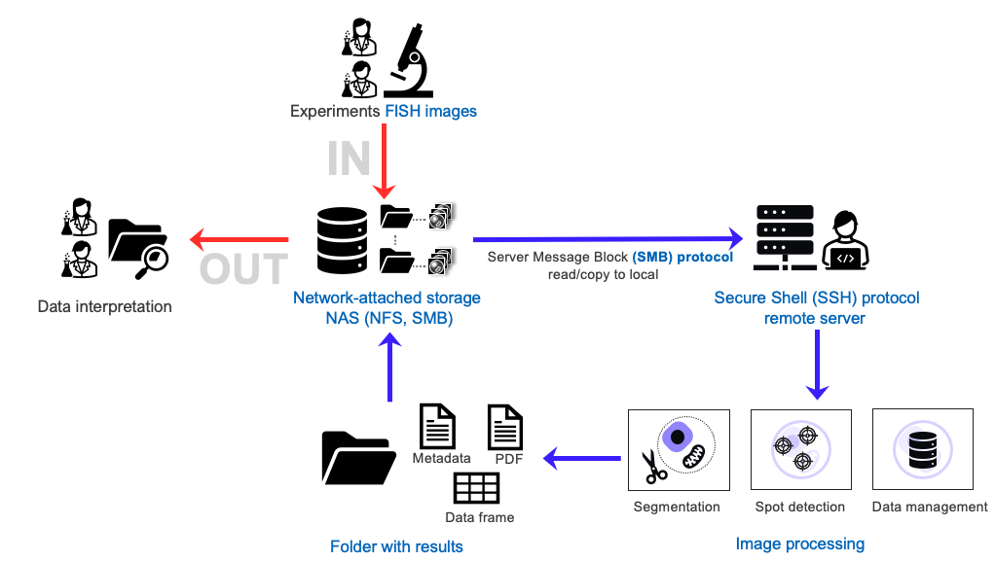
New automated pipeline

Slide 8




Automation
Non-automated (manual) process
selected parameter(s)
Target (#spots)
tuning
parameters
Image(s)
large process(es)
Segmentation/tracking
Process parameters
Data

Slide 9

Automation
Semi-automated (Batch) process – ImageJ macros
User selects representative parameters
Image(s)
large process(es)
Segmentation/tracking
Data

Slide 10




Automation
Automated process (Optimization + ML)
100s cells
1000s spots
pipeline-CLI
automated data management
Segmentation
1
Detection
2
Quantification
¹ Automatic parameter tuning
² Automatic decision taking if an analysis fails
CLI : Command Line Interface

Slide 11


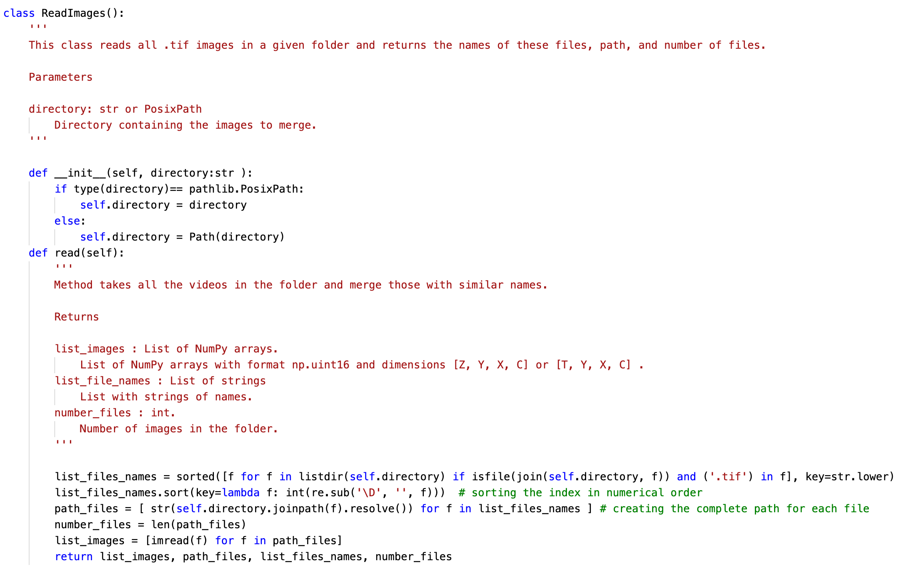
Documentation
comment →
→ documentation
code →
comment →
→ documentation
code →

Slide 12
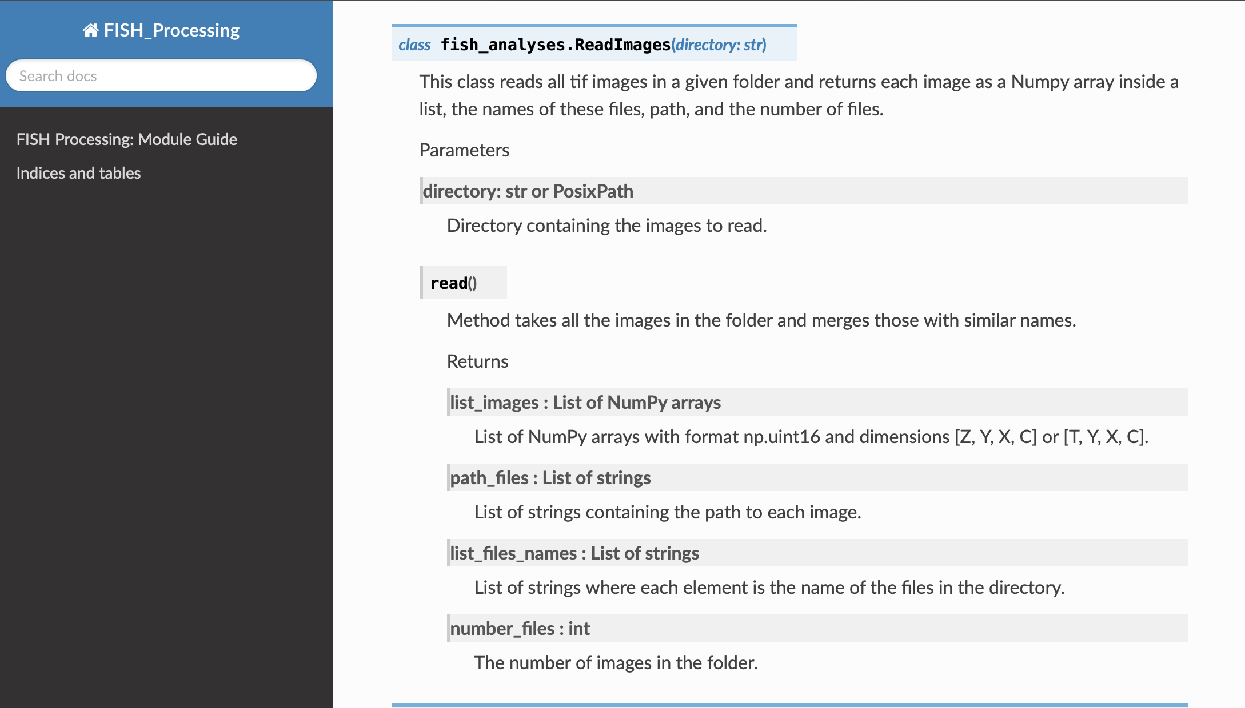
Documentation

Slide 13




Version control + environments = publication quality code
Git-Github
Python virtual environment
new features
version1
version2
master
other user features
conda activate vir_env
pip install croparray
Notes:
In rSNAPed, the simulated software, we are implementing a fully automated pipeline that allows the analysis of single-molecule data sets. rSNAPed models single-mRNA translation using observable fluorescence and mechanistic interpretation.
Segmentation is the first step of the process. Cellpose is a cellular segmentation algorithm written in Python. It is an open-source package that is freely available. It allows us to transform raw simulated image data into interpretable data that we can apply to our experiments. The first step in image segmentation is to segment the images into cell bodies. This is relatively easy when the cells are sufficiently separated from each other, but can become more difficult if the cells are tightly packed together. A mask is then created around the cell bodies with pixels, and all of the pixels are trying to point towards the center. All of these pixels conglomerate as one cell.
The second part of the image processing pipeline includes Trackpy, a python package that tracks dots. It allows us to track fluorescent antibody-based probes that are bound to nascent proteins on single-RNA cells only visible by their beacons of light. The image is represented as a numpy array of intensities. We end up with a field of tracked particles. Results are given as data frames that can be easily saved.
After tracking the spots, we quantify the data by comparing the intensity distributions. We can quantify intensity in every spot. This is done in one method by using disk and donut. You take a tracked spot, and travel a disk and a donut outside of the spot. After drawing a donut outside of the spot, you can calculate the mean intensity of donut and the intensity in the disk.
We then classify these spot intensities based on their color channels. The images have three different color channels: red, blue, and green. We can classify the spots through either single color channels of red, blue, and green, or the combinations of them.
Every part of this pipeline is connected to the simulated cell. It allows us to generate large amounts of data to fully automate the pipeline.

Slide 14


How to use it
Source code
Command line interface
Open source – written on python
OOP / 15 Classes
Github -
Jupyter notebooks
Google Colab / Linux cluster
HTML Documentation - Sphynx
OOP : Object Oriented Programming
Notes:
rSNAPed is an open source code written in python. It uses object oriented programming split into 20 classes. These 20 classes involve calculating intensity and tracking to create the mask in cell pose. For every class, the documentation tells us the parameters we need and the output. Github & PIP is where the code is posted.
The code can be accessed through multiple user interfaces. Jupyter is one interface which can be done on the user's local computer. This requires access to the GIT repository. With Google Colab, the code is free and readily available to multiple users while still allowing Luis to continue working on new versions.
The code can also be accessed through the CSU Cluster. CSU uses a grid engine cluster with Linux as it's operative system. What we've done is create a conda environment with the cluster that allows us to run rSNAPed with required packages and their compatible versions.
On a local computer, depending on the parameter variations, the code can take anywhere from 10 minutes up to multiple hours to run. Using the cluster allows us to run multiple versions of the code at the same time at different parameters. This allows us to generate large data sets that would otherwise take a long time to create.
We are working with the documentation output using sphinx.

Slide 15
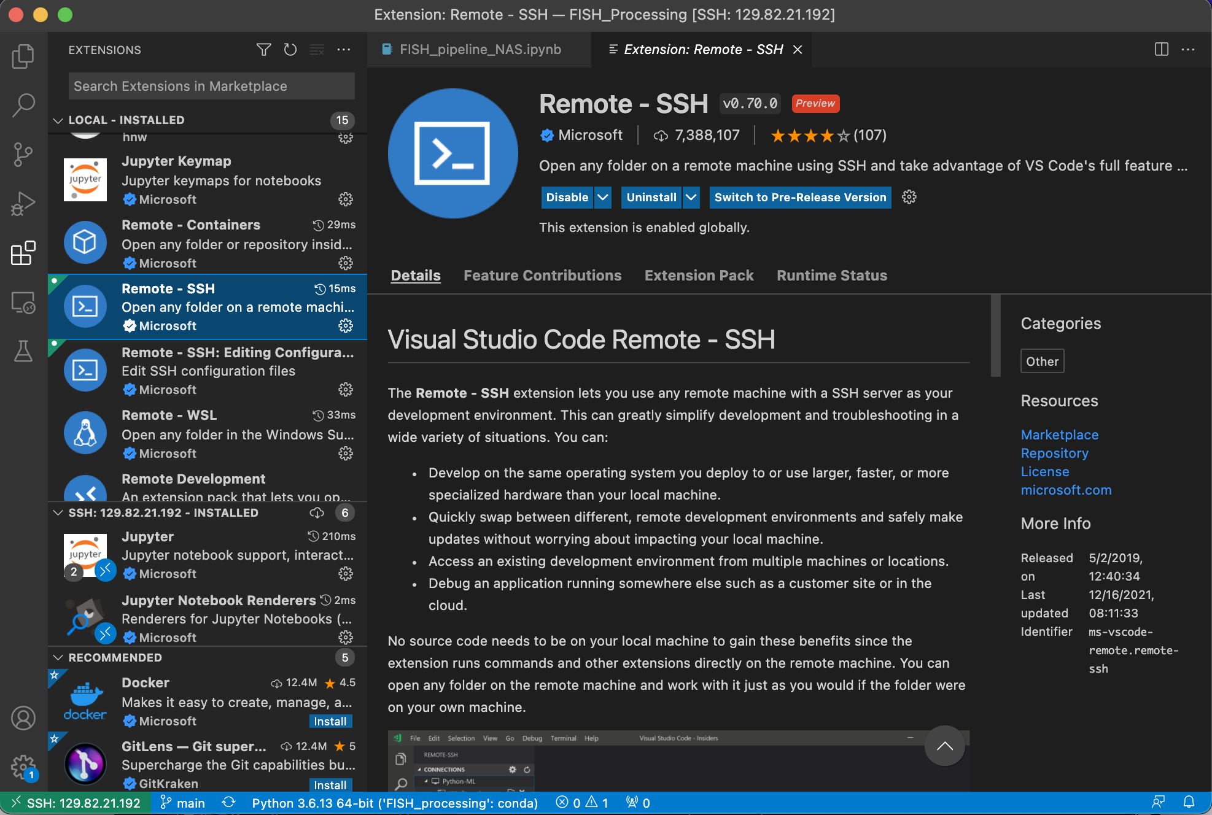
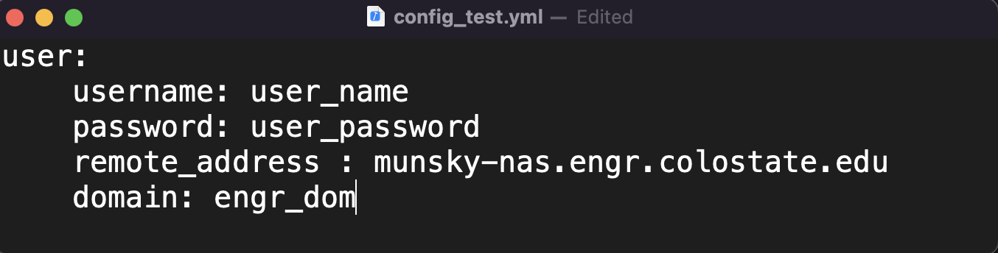
New automated pipeline

Slide 16
Luis Aguilera, Brian Munsky and Tim Stasevich.

